Slide 1
AIRFRAME
WEEK 9 PROGRESS REPORT
BY MARK ODHIAMBO &
VIVIAN MWANGI

Slide 2
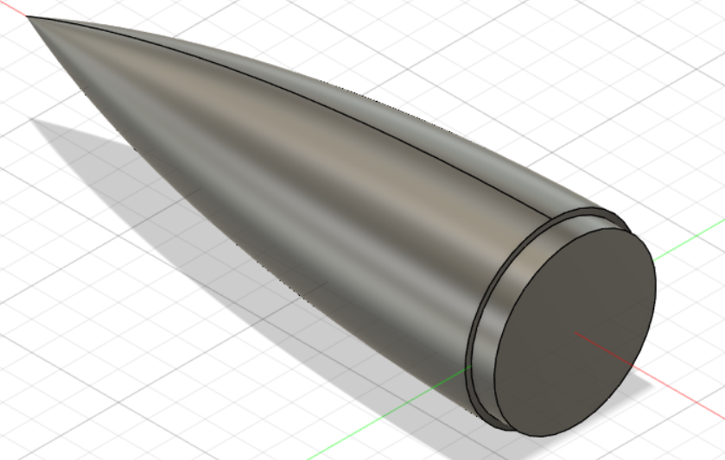
GITHUB #138 NOSE CONE 3D PRINTING

Slide 3
GITHUB #137 RECOVERY SYSTEM
PURCHASE OF MATERIALS
WORK IN PROGRESS

Slide 4
GITHUB #139 FOURTH FABRICATION.
This is the research and fabrication of the forth fabrication.
This includes the following:
The mold cover.
The fins.
The accuracy.

Slide 5
GITHUB ISSUE TO BE DONE.
Github # Forth fabrication.
Github # Ejection test

